Slide 2
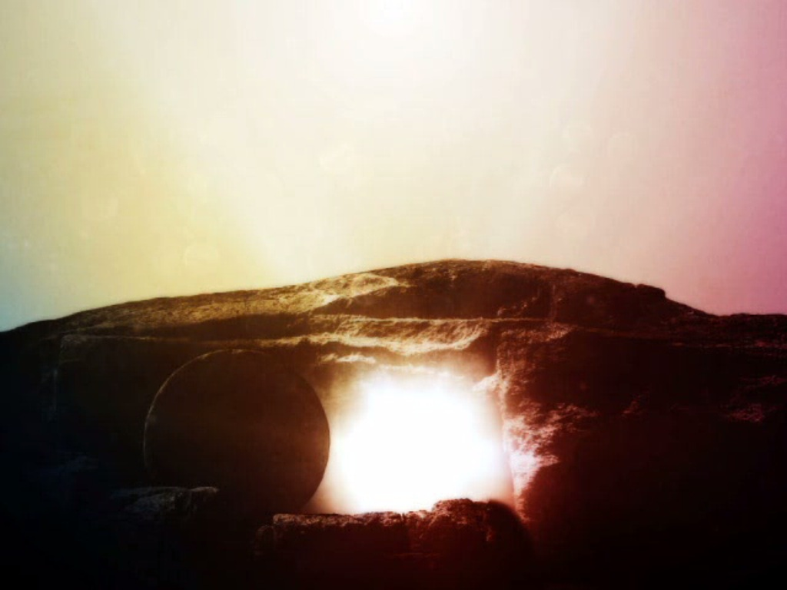

Slide 3
Jesus claimed that He would be raised from the dead
A. In His own words
1. Matthew 12:38-41; 16:16-21; 17:22-23; 20:17-19; 26:31-32
2. Mark 8:29-31; 9:30-31; 10:32-34
3. Luke 18:31-33
4. John 2:19-22
B. These claims demand a response
1. Matthew 27:62-66
2. C.S. Lewis

Slide 4
His disciples believed and taught that they had seen Jesus after He was raised from the dead
A. The disciples before the crucifixion
1. Peter did not believe and rebuked the Lord – Matt 16:22; Mark 8:32
2. They did not understand and were afraid to ask – Mark 9:32; Luke 18:34
3. They were deeply grieved – Matt 17:23
4. They all forsook Him at His arrest – Matt 26:56
5. Peter denied Him openly – Matt 26:69-75

Slide 5
His disciples believed and taught that they had seen Jesus after He was raised from the dead
B. The disciples after the resurrection
1. Apostles spoke boldly of the resurrection in Jerusalem and the temple – Acts 2:14-36; 3:11-26
2. “…we cannot stop speaking about what we have seen and heard.” – Acts 4:8-22
3. “We must obey God rather than men.” – Acts 5:27-32
4. Taught daily in the temple – Acts 5:40-42
5. Paul constantly delivered to death – 2 Corinthians 4:11-14

Slide 6
His disciples believed and taught that they had seen Jesus after He was raised from the dead
C. Non-Biblical sources
1. Clement of Rome, a bishop of Rome
2. Ignatius, a bishop of Antioch
3. Justin Martyr, a major Christian apologist of the second century
4. Origen, quoting Phlegon

Slide 7
External sources confirm the disciples’ belief in the resurrection of Jesus and their devotion to serving Him
A. Josephus, Antiquities 18: Ch 3
B. Tacitus, Annals 15.44
C. Lucian of Samosata, The Passing of Peregrinus, 11-13
D. Suetonius, Nero, 16
E. Pliny the Younger, Letters, translated by William Melmoth, volume II, X:96.

